Slide 1
Engineering Interactive Visual Interfaces for Data Science (“The CS Data Vis Class”)
xkcd

Slide 2
Friday February 9
Engineering Interactive Visual Interfaces for Data Science
“The CS Data Vis Class”
Dr. Jillian Aurisano
Plan for today:
Logistics
Perception
Visual channels
Design critique activity
Notes:
So welcome to engineering visual interfaces for data science. I'm Dr Aurisano.
Thanks for finding the class on Zoom. Hopefully we will be in person again soon.
If anyone out there is comfortable turning on their cameras, that is lovely- then I feel like I am talking to students, rather than to myself.
Here’s our plan for today:
First I’m going to introduce myself, so you know a bit about me
Then we are going to get to know each other, in Zoom breakout rooms. This will give us a chance to make sure that Zoom breakout rooms work, and we all know how to access them.
Then, I am going to walk through the structure, and plan for the course. I want to make sure everyone knows how the course will work, and what to expect, and also a bit about why the course is designed this way.
Then I am going to introduce the class, and what the class is about. Since this is a new class, and one of just a few classes in human centered computing here at UC, I wanted to give an overview of the topic.
Then I have an introductory activity, which we will do in breakout rooms, and which I think will help motivate the discussion on Wednesday, and getting into the meat of the class.

Slide 3
Project 1 geojson file

Slide 4
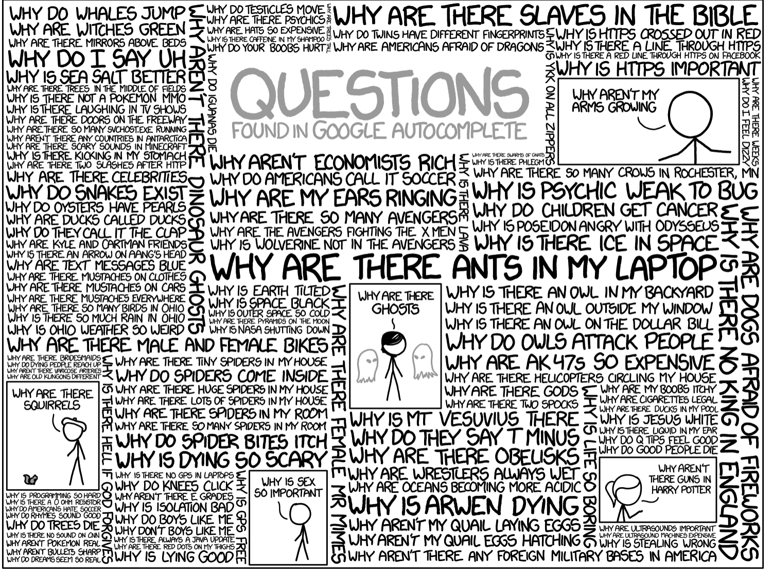
Questions?

Slide 5
Perception vs Cognition
Perception is:
Identification and interpretation of sensory information
Physical stimulus through a sensory system to recognition
Shaped by learning, memory and expectation
Not conscious
Cognition is:
Processing information
Applying prior knowledge
Reasoning, inferring, making sense of information
Hear someone say something -> Perception
Understand the meaning of what they are saying -> Cognition

Slide 6
Why should we understand perception and cognition?
Understanding perception is important for effective visual design
How to choose colors
How to show relationships
How to draw attention to visual features
How to minimize distractions
How to avoid biasing your viewer
Understanding cognition helps us support tasks that users of our visualization need to perform
How to reason about data
How to allow people to develop insights based on what they are seeing

Slide 7
Let’s start by talking about perception
Today:
What we see
Vs
What is there

Slide 8
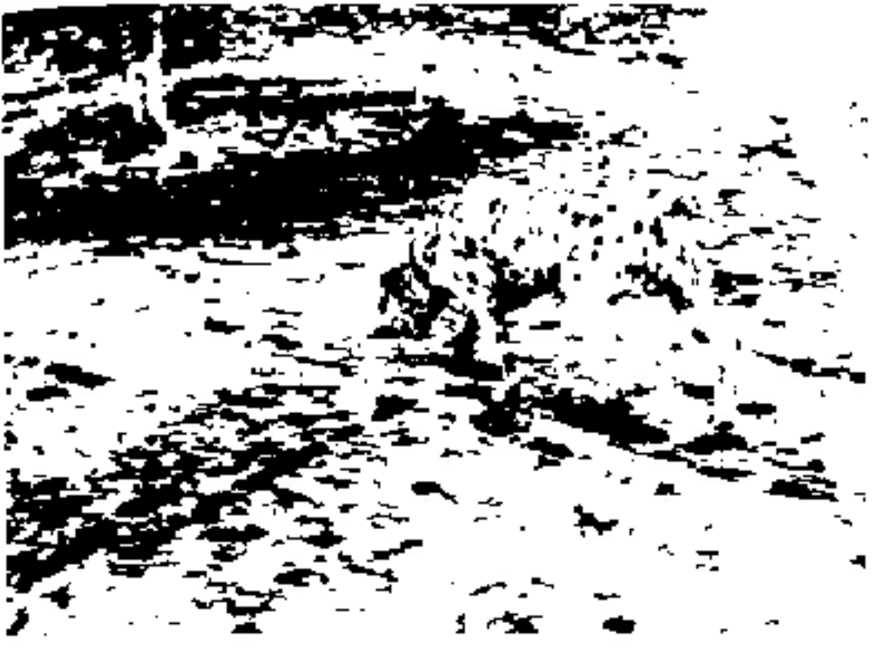
Who can see something here?
Emergence of images

Slide 9
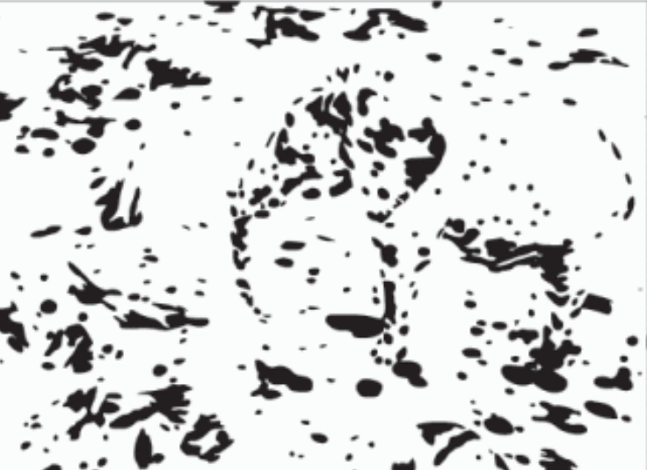
What about here?

Slide 10
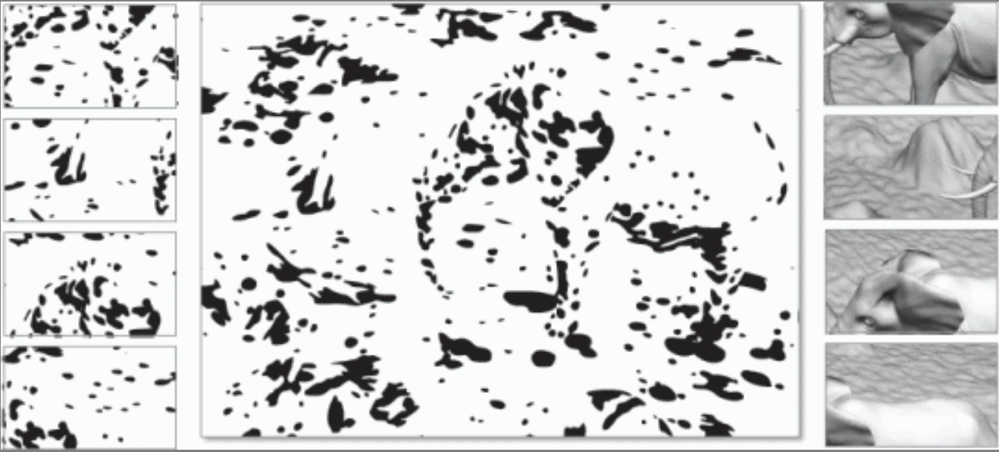
Need to see the whole- just looking at parts does not work
We need the whole picture
Our mind matches the concept with the features as a whole
http://graphics.stanford.edu/~niloy/research/emergence/emergence_image_siga_09.html

Slide 11
Perception is based on priors
We have a model of the world
Expectations
Prior experiences
Our perceptual systems take in raw information and then our brains try to fit raw information into a model

Slide 12
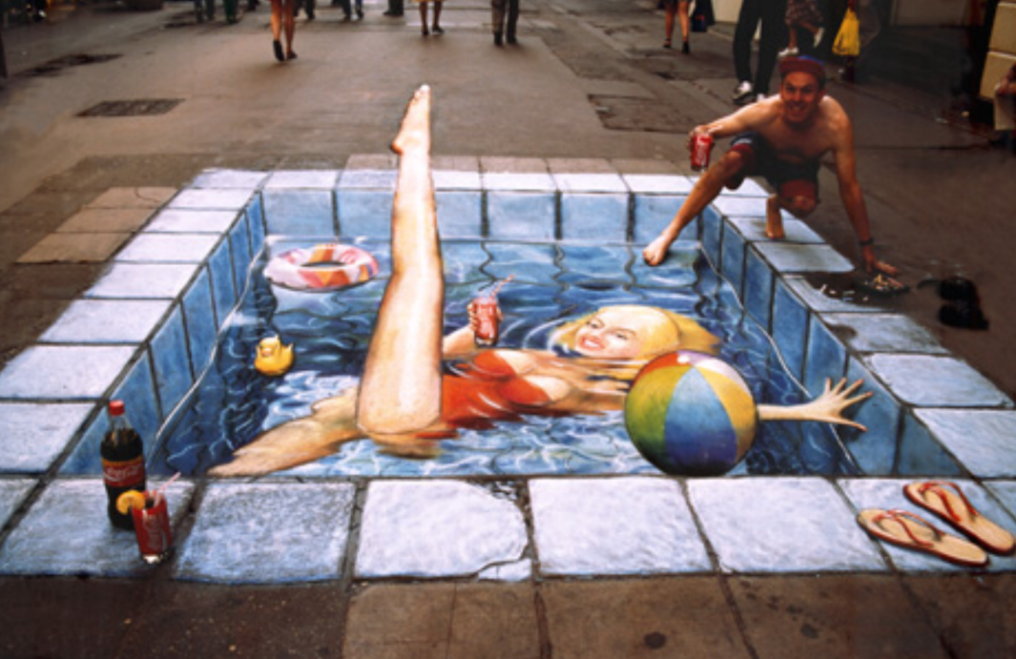
What we see

Slide 13
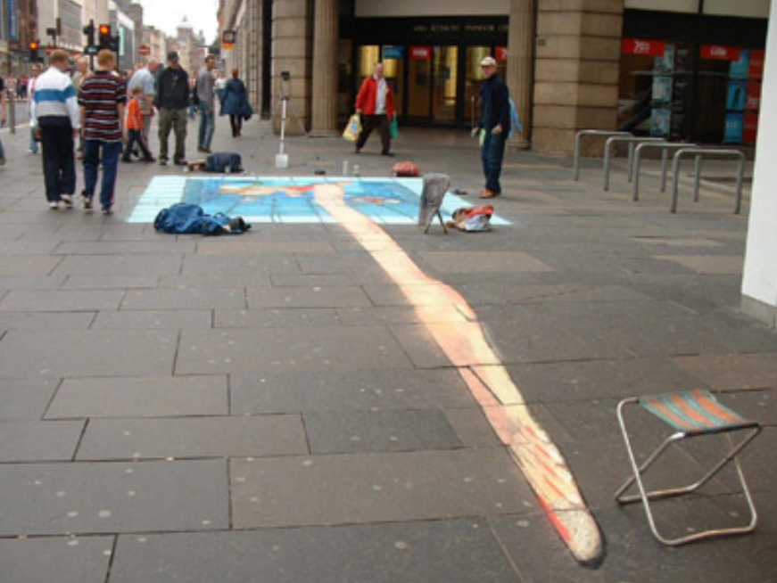
What is there

Slide 14
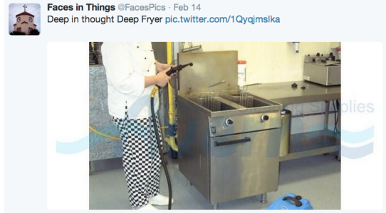
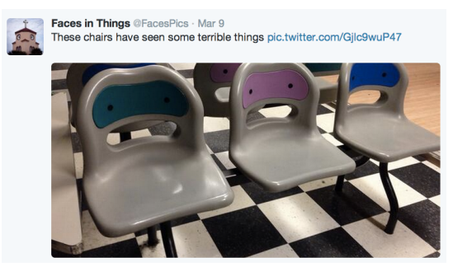
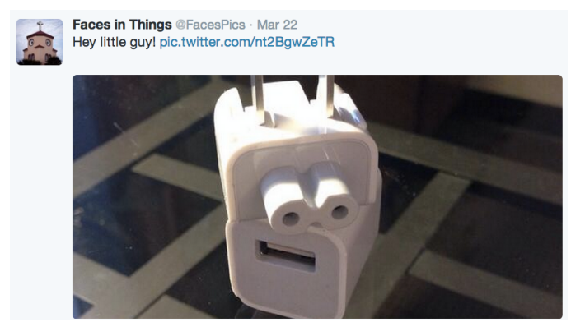
In-appropriate application of priors
Apply priors inappropriately
Pareidoia
We see faces (which our brains are very well trained to see)
Where there aren’t faces

Slide 15
Take home point
Vision is ”constructed” top-down from the input

Slide 16
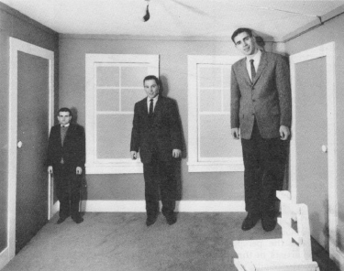
Human visual system
What we see depends on our goals and expectations
This is how some optical illusions work
Relative judgements are strong
Absolute judgements are weak
Who is taller?

Slide 17
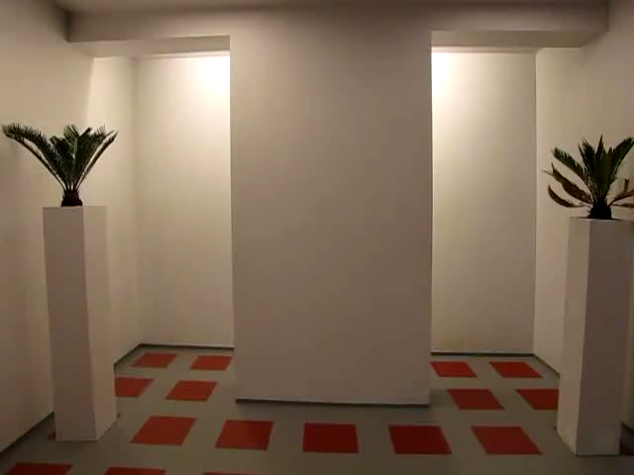
Tricked you!

Slide 18
Size perception
We don’t perceive size absolutely
But in relation to surroundings
Our brains makes a judgement of what the size is, it is not something we just see

Slide 19

Color: Brightness is relative
Perceived brightness of an object is relative to its background

Slide 20


We don’t perceive colors absolutely But relative to surroundings
All the rectangles are the same color on the top and on the bottom
But we perceive them differently

Slide 21
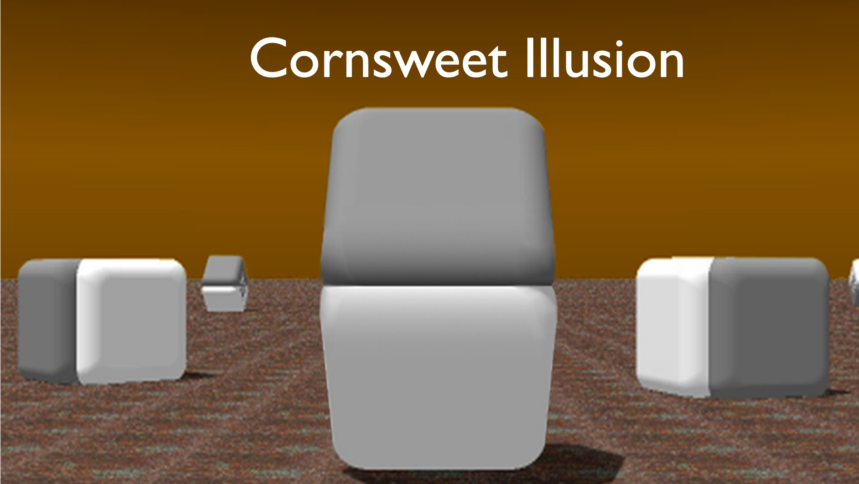

Which is darker?

Slide 22
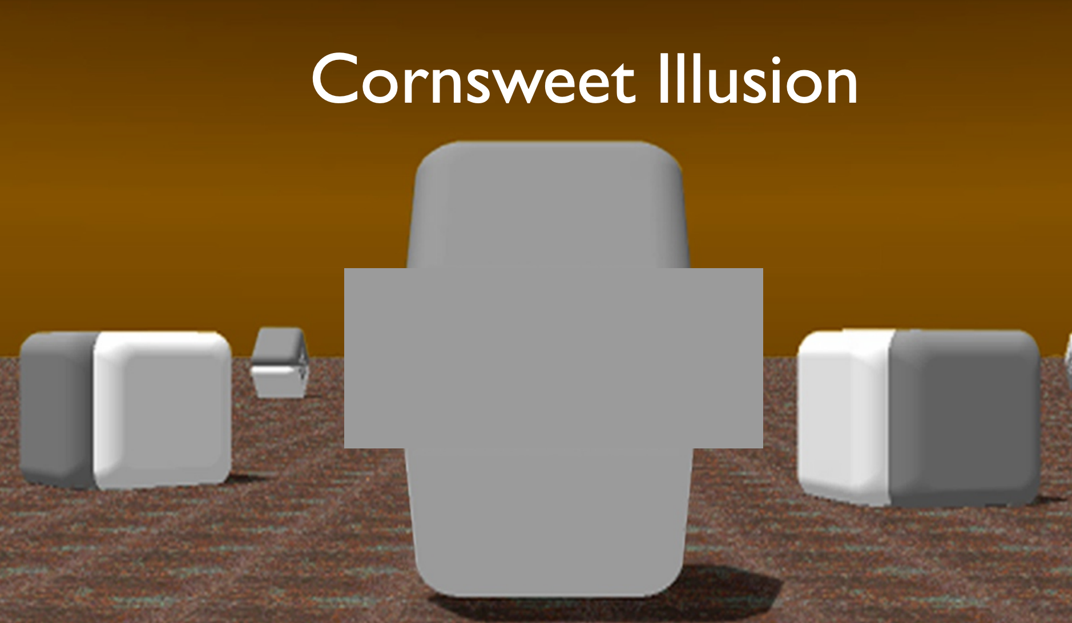
Which is darker?

Slide 23
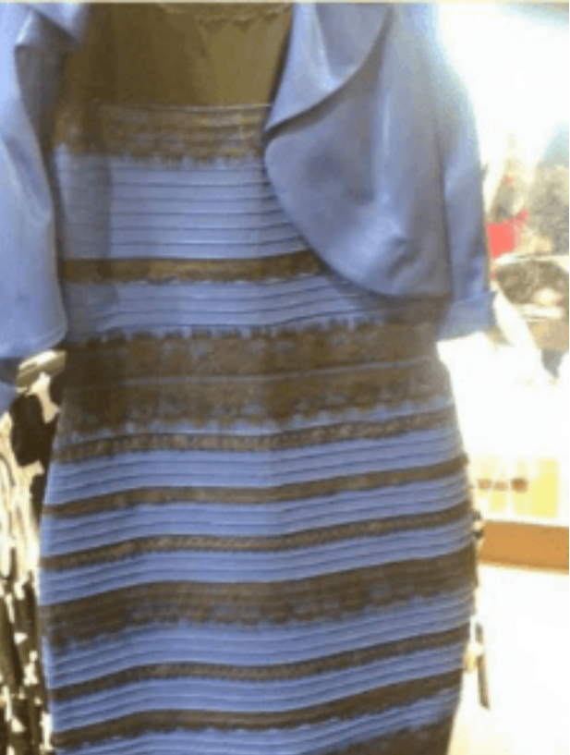
The dress
What colors are in the dress?
Black and blue?
White and gold?

Slide 24
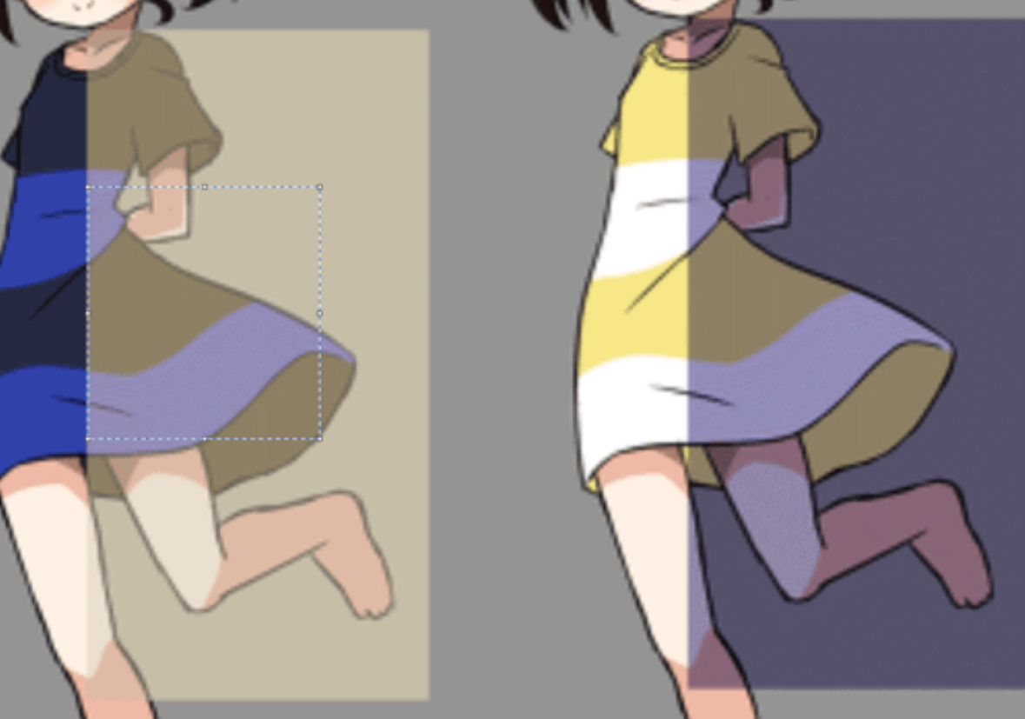
The dress
It actually is blue and black but….
Your brain makes an estimate of the color based on what is perceives to be the lighting in the room
People now study this….
57% blue and black
37% white and gold

Slide 25
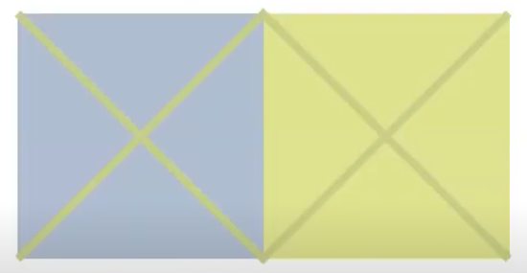
Interaction of color: background effect

Slide 26
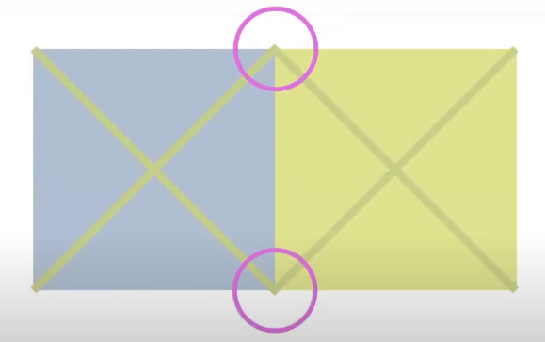
Interaction of color: background effect

Slide 27
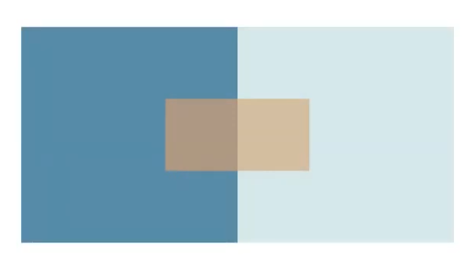
Placement matters in color perception
Close together these colors look different

Slide 28
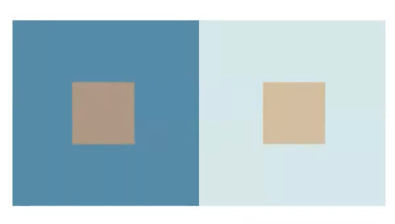
Placement matters
Move them apart, and they look more similar

Slide 29
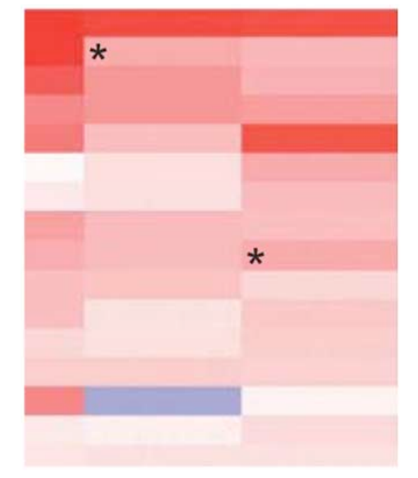
Why does this matter for visualization?
We often use heatmaps
Example :
Is the one on the top lower or higher in value (where darker red is a higher value)
Be aware of this
Is this the right visualization for this?

Slide 30
Change blindness
https://www.youtube.com/watch?v=FWSxSQsspiQ&t=69s

Slide 31
Gradual change test
https://www.youtube.com/watch?v=1nL5ulsWMYc

Slide 32
Why does this matter for vis?
When we use change- animation- to transition or signal importance
People may miss it
Perception beats memory or detection of a change
But, not all dramatic enough to register

Slide 33
Attentional blindness
https://www.youtube.com/watch?v=vJG698U2Mvo

Slide 34
How do we see things in the first place?
Is our visual system like a camera?
where all the light comes in, strikes our eye, registers in our brain?

Slide 35
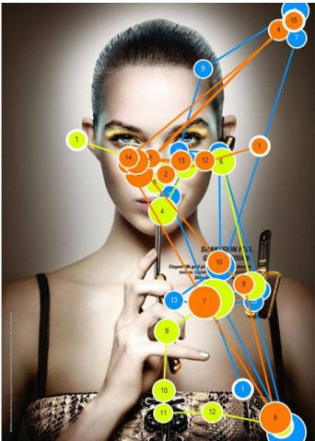

Human visual system
Our experience may feel like vision is like a camera but….
Vision is a sequence of
Fixations- maintain our gaze on a single location (200-600ms)
Saccades- move to a different location (20-100ms)
This is unconscious, happens so quickly you don’t know it is happening
Illustration: eye tracking data- where did someone look if you track their eyes

Slide 36
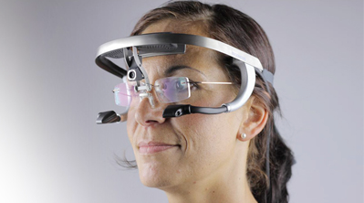
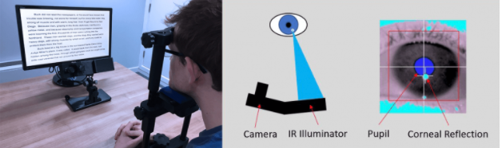
Eye tracking

Slide 37
Example of where we are looking
https://www.youtube.com/watch?v=DIEO0ZHgLSU

Slide 38
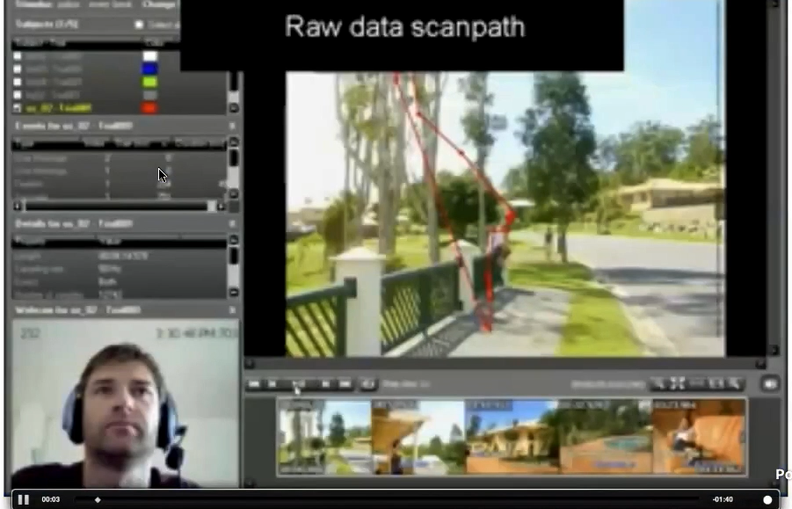
Eye fixations and reading

Slide 39
How is this relevant
You can study eye movements and visual interfaces
Ensure that users are seeing what they want them to see
Good to know that we aren’t registering the whole picture uniformly
Reason to think about how to organize content
How we encode data to draw attention

Slide 40
What is involved in designing a visualization?
Encoding the data visually
So that people can perform tasks that help them gain insight into their data
We need to understand
Visual channels: The possibilities we have available to us for encoding data
Perceptual Tasks: What our perceptual systems can do do when given visual information

Slide 41
Visual channels
Perceptual tasks
Size (height, width)
Positioning (density, proximity)
Shape (curvature, closure)
Orientation (angle, rotation)
Color (hue, saturation and value)
Animation (movement, flicker)
How strong are these channels?
How do they work together?
Target detection
Boundary detection
Similarity detection
Detection of Association/group membership
Detection of Importance
Detection of Connectedness
Detection of Symmetry
Do some visual channels enable these perceptual tasks better than others?

Slide 42
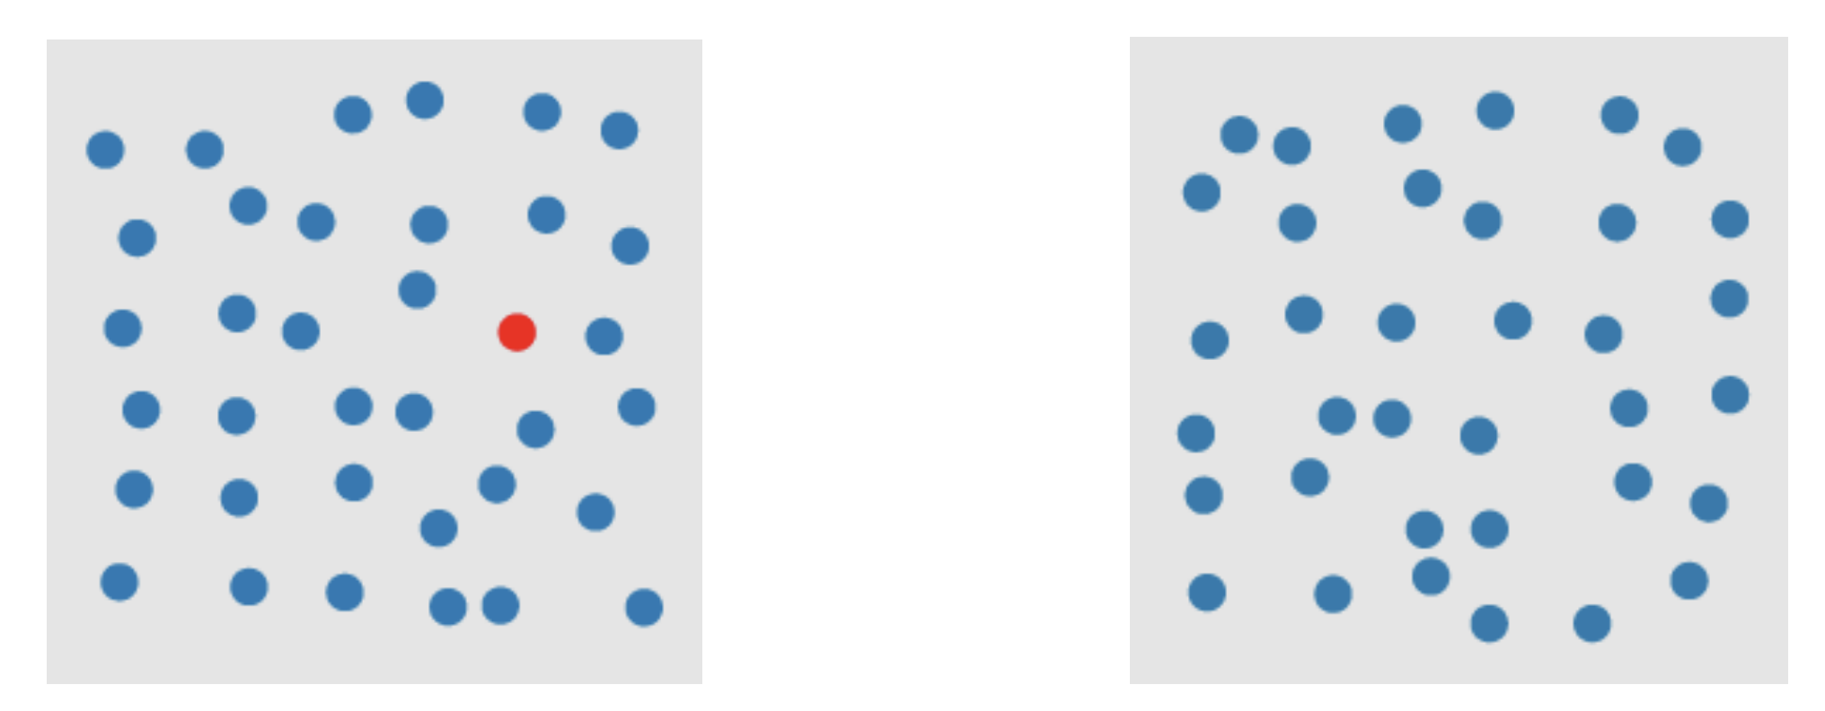
One example
What visual channel is being used here?
What task does that visual channel enable you to perform?

Slide 43
One example
Visual channel: Difference in hue -> Perceptual task: target identification

Slide 44
One example
How hard was it to perform this task?

Slide 45
Pre-attentive properties (“Popout”)
Properties we can perceive very well through low-level visual systems, without effort. Automatic.
Pre-attentive detection vs sequential search
Pre-attentive: fast, automatic, in parallel, accurate
Sequential search: slow, serial, can be inaccurate
Pre-attentive features can be detected even in the presence of many ”distractors”
Sequential search performance decreases with distractors

Slide 46
Value for visualization
Useful to understand how low-level perceptual tasks can be supported by different visual properties
How to choose ”good” encodings of data, that are going to be perceived by your user
Choose encodings that support tasks pre-attentively
Better than visual search

Slide 47
Experiment
Let’s test how quickly you detect the target (perceptual task)
This is going to be a bit difficult to measure, because it is fast, but just for illustration…
Clap when you spot the target

Slide 48
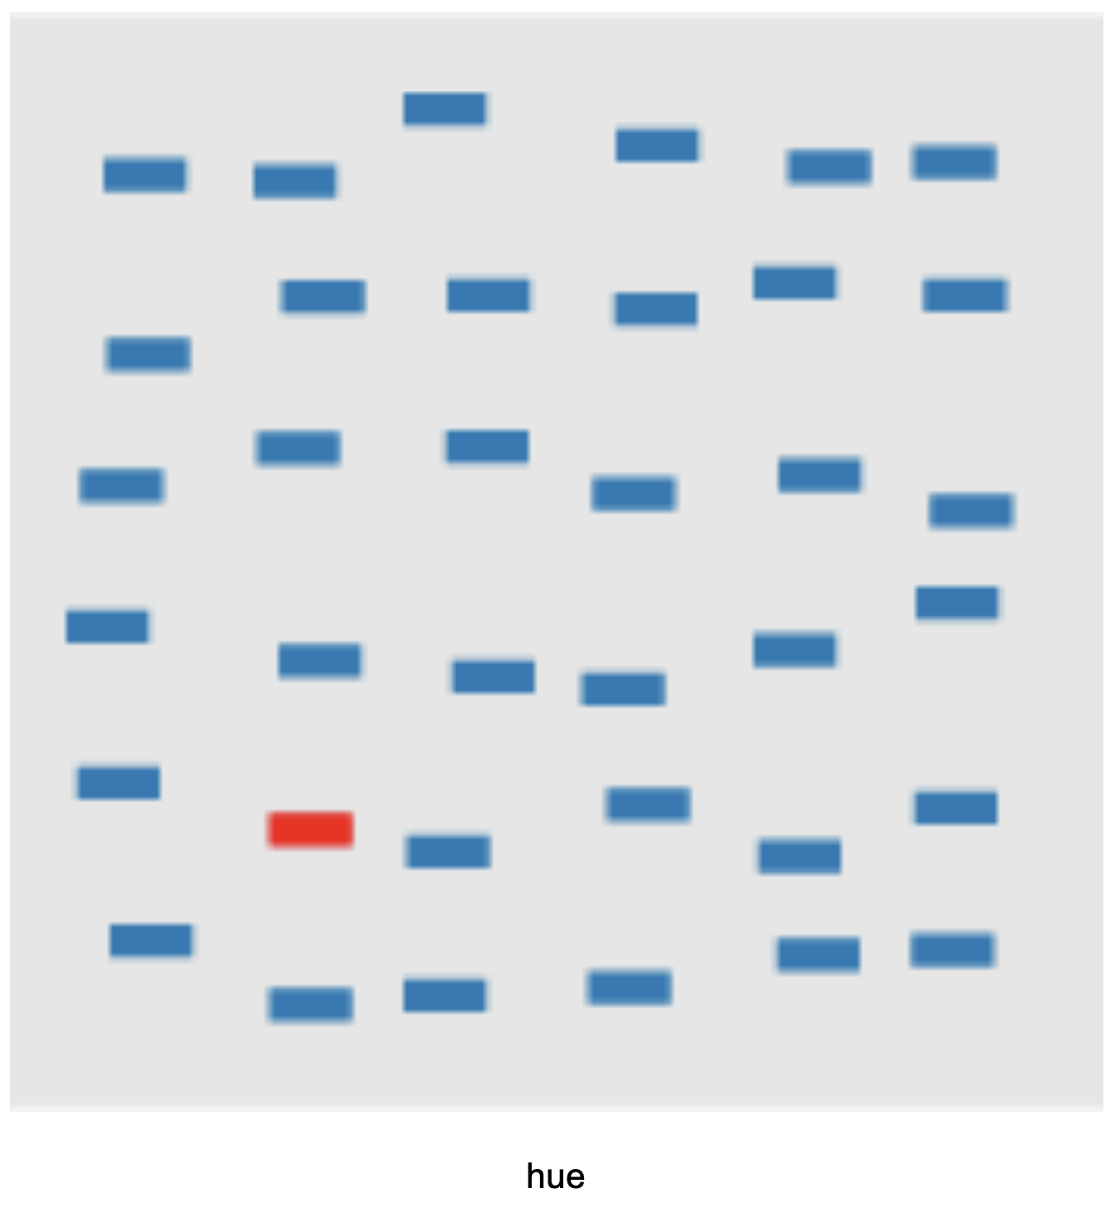
Hue

Slide 49
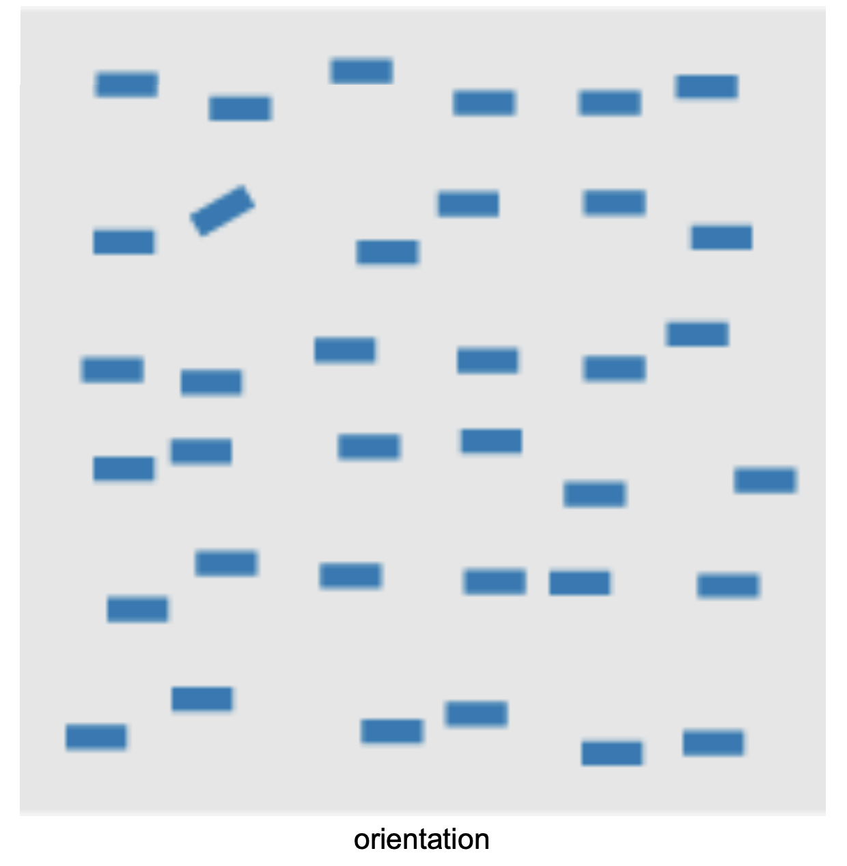
Orientation

Slide 50
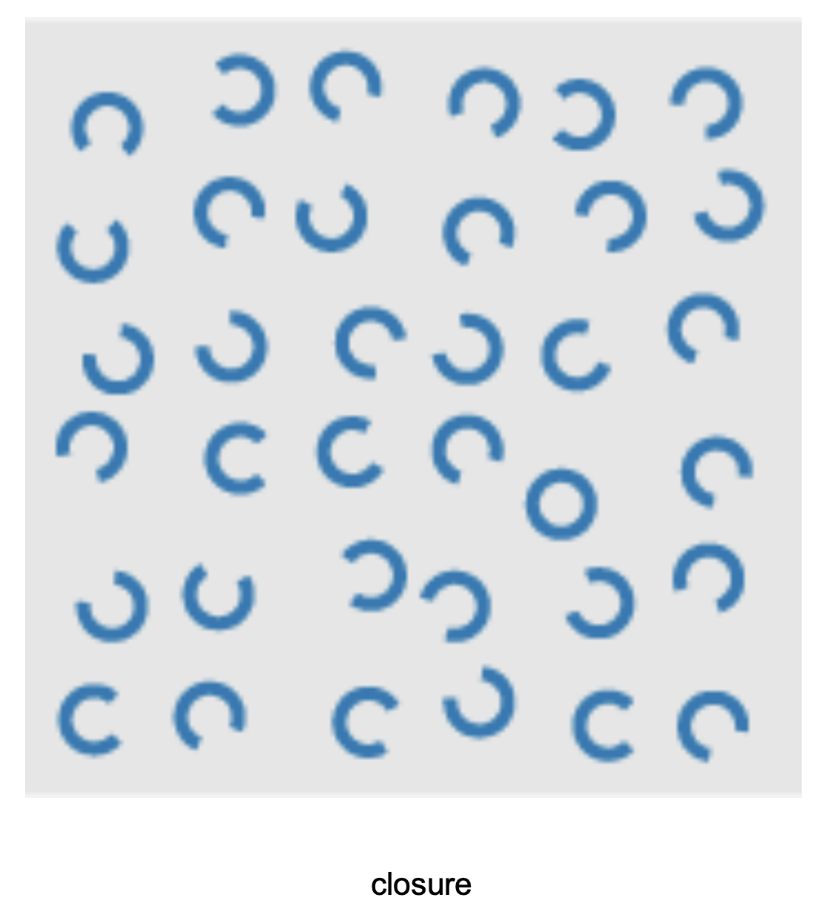
Closure

Slide 51
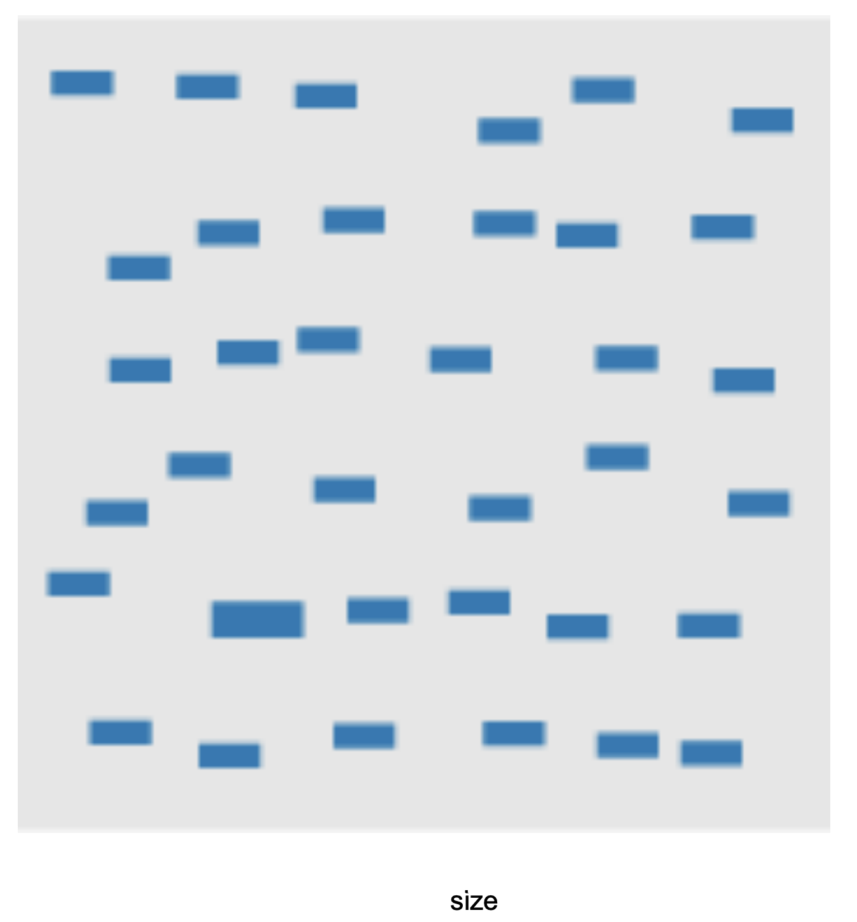
Size

Slide 52
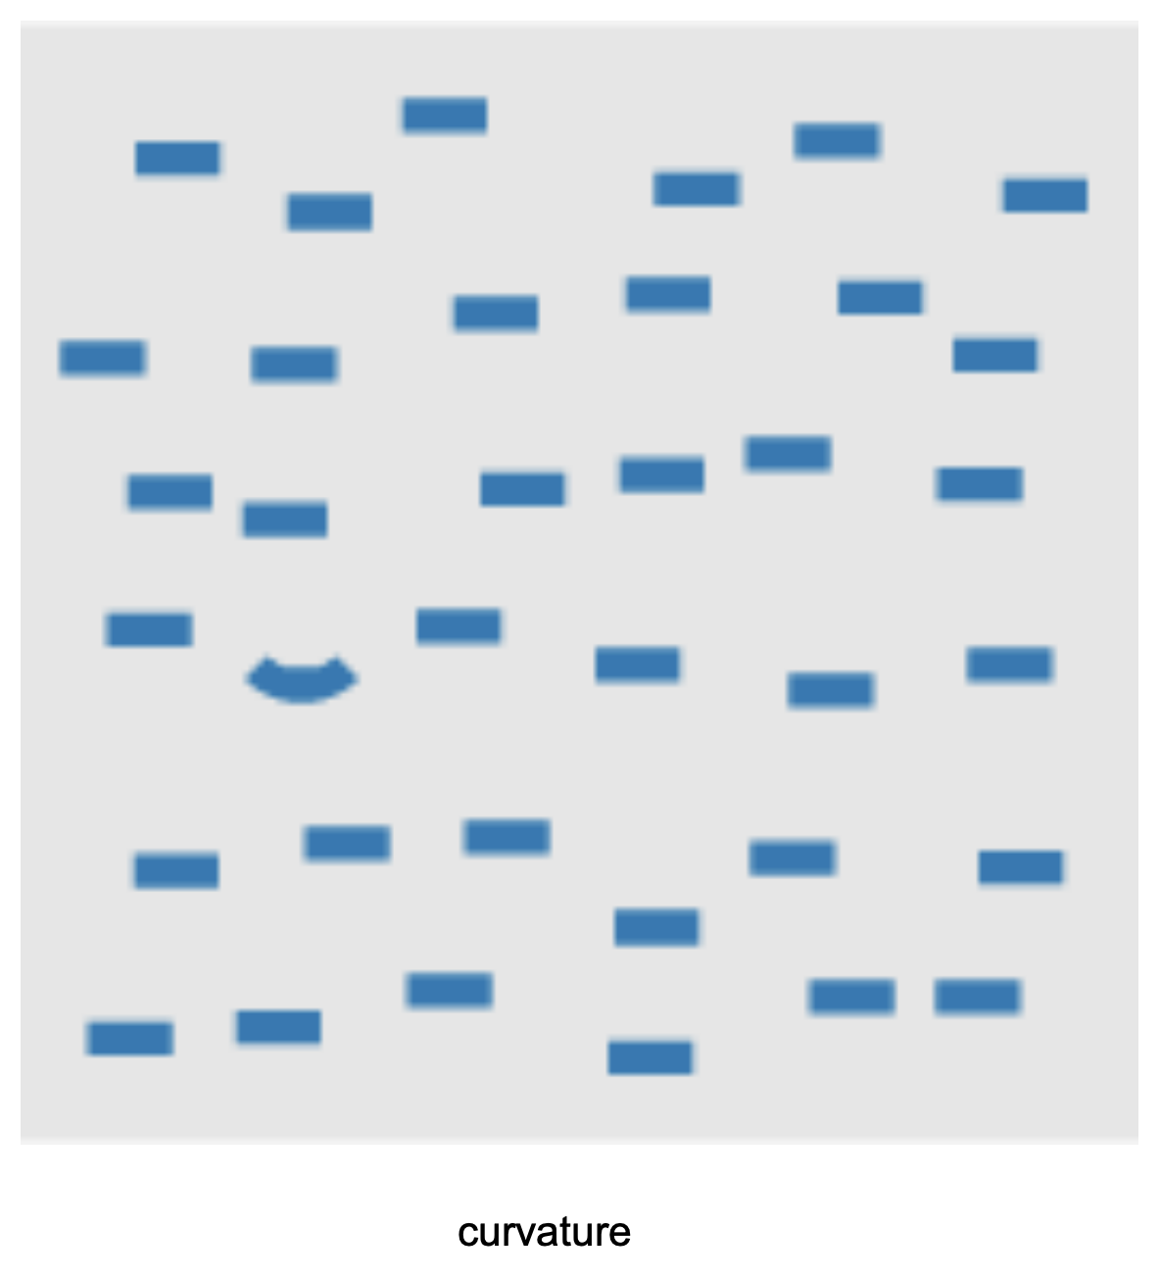
Curvature

Slide 53
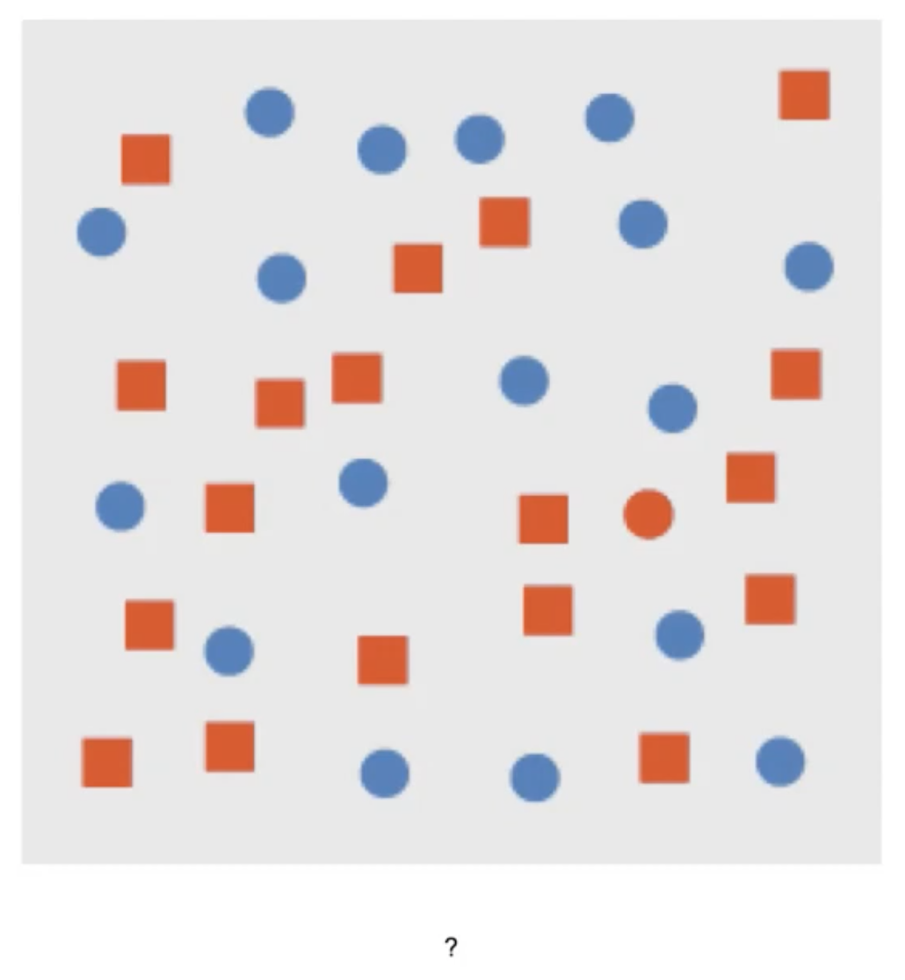
?

Slide 54
Combination
All circles are blue
All rects are red
Except our target: a red circle

Slide 55
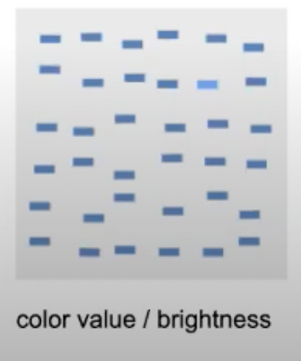
Brightness

Slide 56
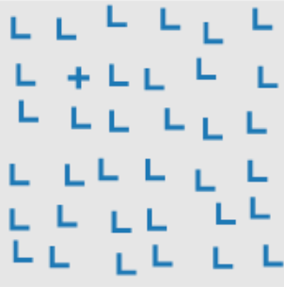
Intersection

Slide 57
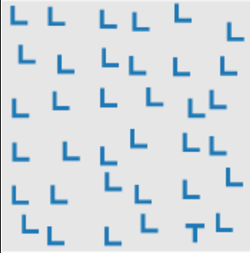
Terminators

Slide 58
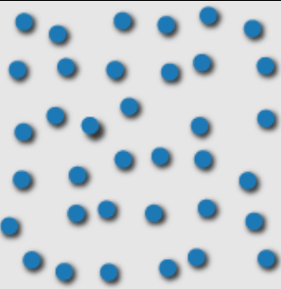
3D depth cues

Slide 59
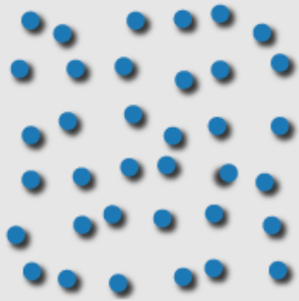
Lighting direction

Slide 60
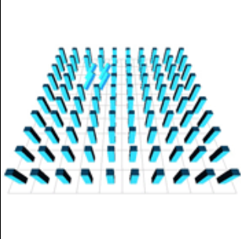
3D orientation

Slide 61
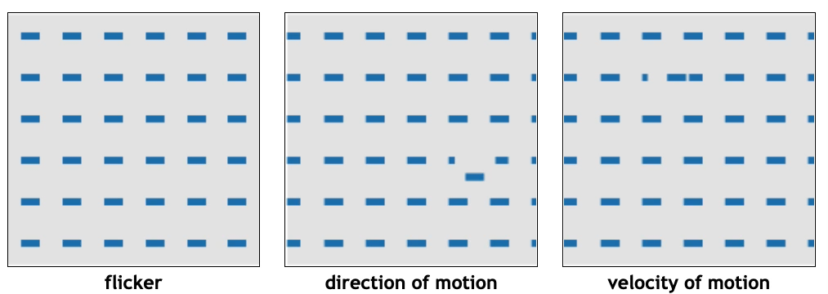
Animations

Slide 62
Some of these were faster, more accurate than others…

Slide 63
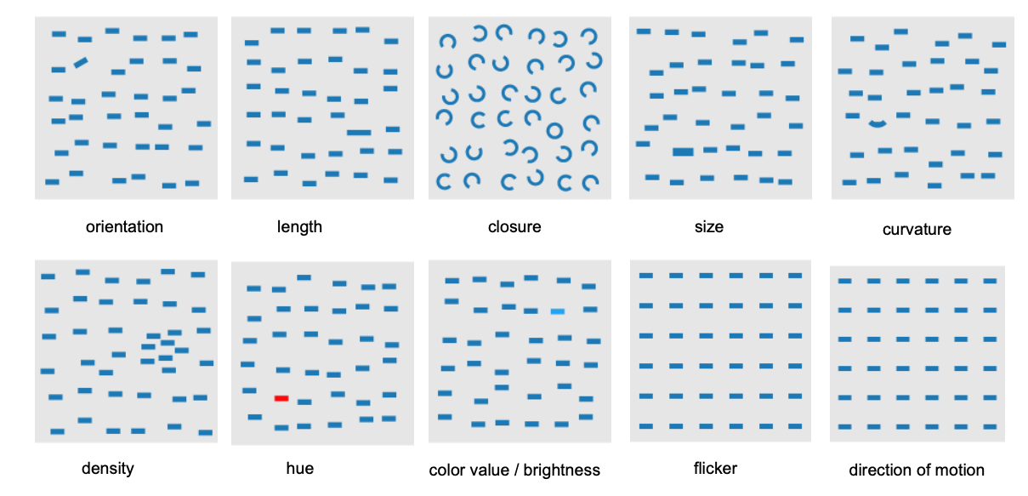
Returning to our initial goal: ’pop-out’
What visual channels allow a target to ‘pop-out’ at us?

Slide 64
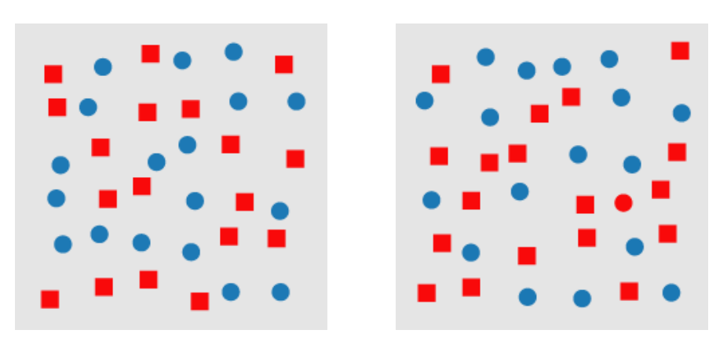
Combinations
Why is this target detection task hard?

Slide 65
Combinations
Difficult for people to perform a low-level perceptual task around a combination of visual channels
Target is a red circle
Distractors are blue circles and red squares (have both properties)
No one visual channel needs to be detected, but a combination

Slide 66
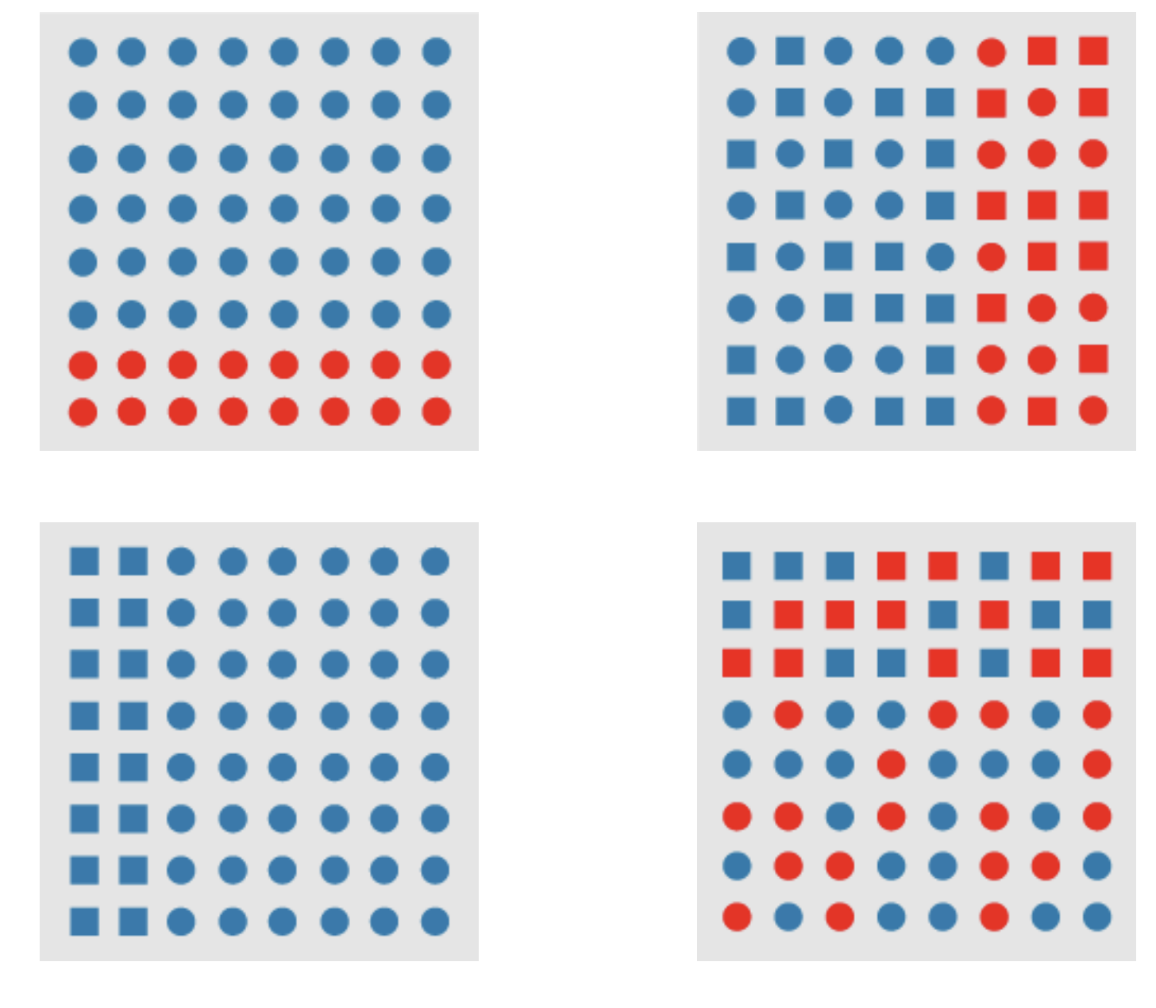
Boundary detection
Hue
Shape
Hue or shape defines the boundary, but other visual channels are distractors
Which of these visual channels works better for boundary detection?

Slide 67
Boundary detection
Color > shape?

Slide 68
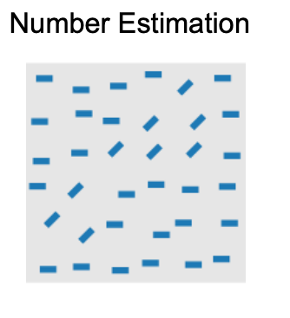
Number estimation
Are there more diagonal rectangles than horizontal?
Don’t count- around how many are diagonal?

Slide 69
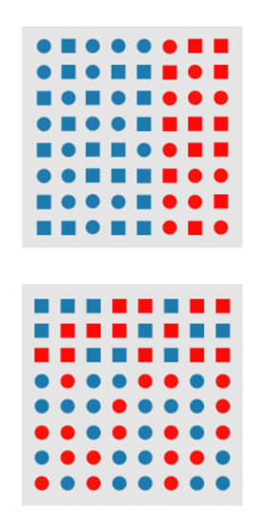
What about these tasks?
Similarity detection
Detection of Association/group membership
These task bring us to Gestalt principals

Slide 70
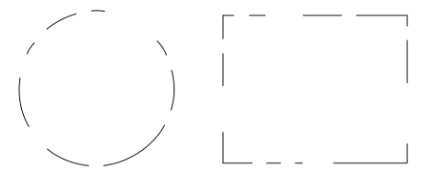
Gestalt principles: Patterns that transcend the visual stimuli that produce them
One example- these distinct lines come together and are perceived as part of a whole

Slide 71
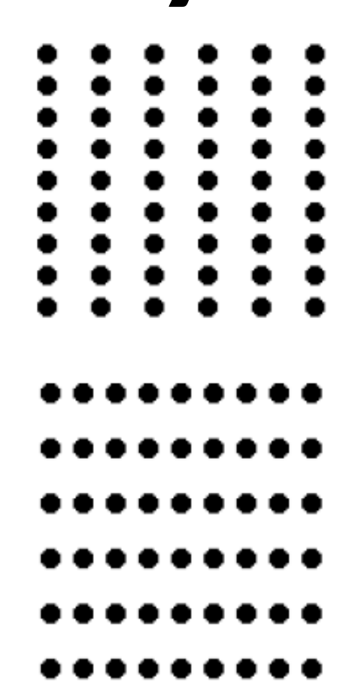

How to convey association or grouping?
Proximity
A set of elements in close proximity can create groups that we perceive together
Grouping elements together, lining them up, creates association

Slide 72

Proximity vs color for grouping?
What to you conveys being a group more strongly? Color or proximity?

Slide 73
Proximity vs color for grouping?
Proximity can be stronger than color
We see the elements grouped together spatially (proximity) as the primary association
Color we would think of as a secondary association

Slide 74

Change proximity, change association
a

Slide 75

Proximity to express relatedness, or group membership
Principal of dimensionality reduction techniques (which we will cover later)
take high dimensional data
Embeds in 2d space
Proximity -> similarity

Slide 76
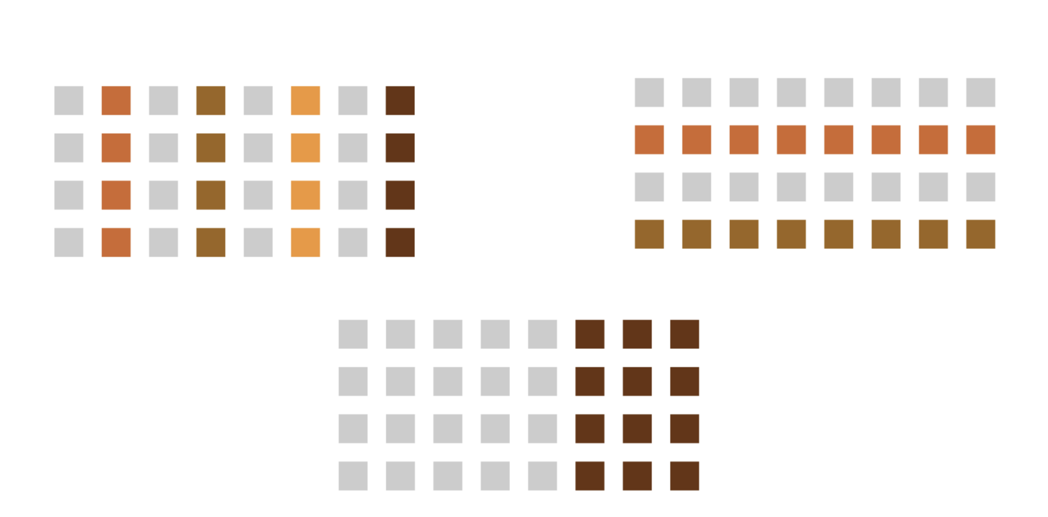
Similarity of elements: through Proximity + Color
Can use color in combination with proximity to convey similarity

Slide 77
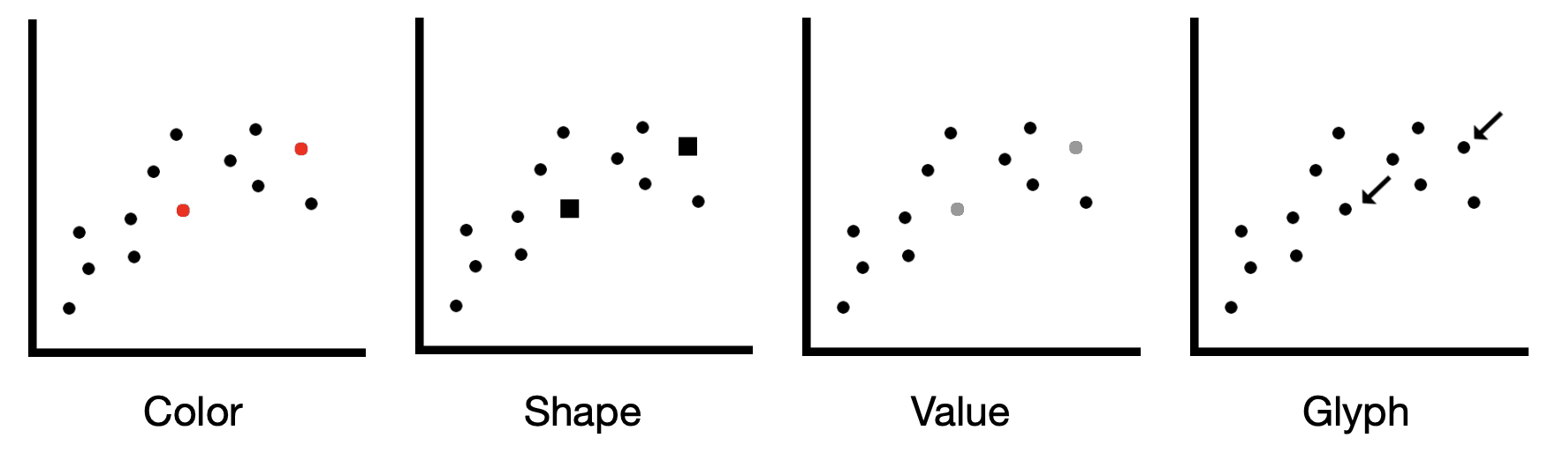
Convey similarity without proximity
Color, shape, size, value, orientation
Adding glyphs, labels, frames, backgrounds

Slide 78
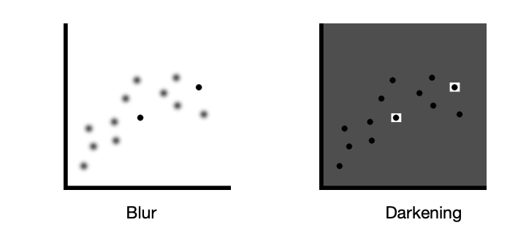
Convey similarity with blurring out, darkening everything?
Modulate everything but the similar elements
Blur everything
Darken everything
De-saturate everything

Slide 79
But you can lose context
Ok for drawing attention, or highlighting features
But not ideal

Slide 80
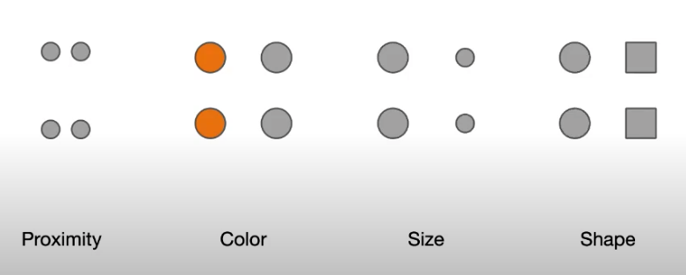
Let’s do an experiment
What looks grouped together? What is associated?

Slide 81
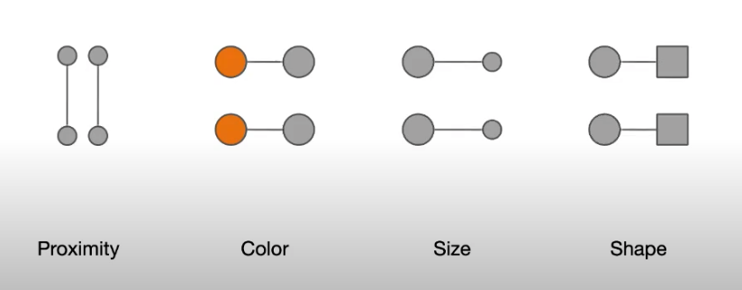
Let’s do an experiment
What if we add lines to visually connect elements
Which wins? What way of expressing connection is more salient?

Slide 82

Conveying association through connection
Explicitly represent it through a line or a curve
Drawing a region, surface or volume
Override proximity or other grouping principals

Slide 83

Can you see how these elements are connected?
Shape alone to convey association

Slide 84
Can you see how these elements are connected?
What if we draw these associations
And what if we highlight the salient pattern?
Makes a difference

Slide 85

Grouping elements by drawing a region

Slide 86

Visualization example:
How to show set membership of geolocated items, without losing geospatial positioning
Could use colored points
Here they use lines and regions to show set membership

Slide 87
Review:
Showing association, connection, grouping
Can be done through different visual channels: color, proximity, shape, line connections, area connections
Some visual properties will convey connection, association, grouping more strongly than others.

Slide 88

Perception of continuity
We assume items continue along the same trajectory, or in a pattern

Slide 89

Perception of continuity and path following
Suppose you want to show connection within many elements
Edge routing problem, for network data
Which do you prefer? Which supports path following or identification of related elements?

Slide 90

Perception of symmetry
Our perceptual systems love symmetrical things
We are good at detecting symmetry and breaks in symmetry
Our preference for symmetry can be used to convey information, and used to manipulate

Slide 91

Detecting symmetry, breaks in symmetry
Visually detect symmetry - > similar patterns in data
Visually detect breaks in symmetry - > different patterns in the data

Slide 92
Take-aways
Our perceptual systems are optimized for seeing groups, associations, paths, symmetrical shapes
We can leverage these perceptual processes when we select ways to visually encode data

Slide 93

Design critique
Let’s look at this visualization, and discuss the strengths and weaknesses
How is the data encoded visually?
Shape, color, position, size, 3d
How easy is it to understand this vis?

Slide 94


Slide 95

Redesign

